Slide 2
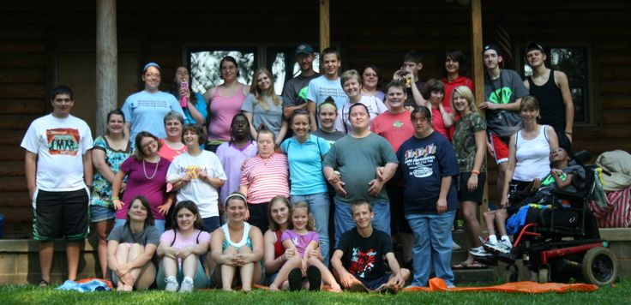
Wilson County Baptist Association
Special Needs Praise and Worship Day
March 5th
5:00 pm to 7:00 pm
Immanuel Baptist Church

Slide 3
Community Easter Sunrise Service
In The Fairview Cemetery
March 27th at 6:00 am
Fall Creek Will Host A Breakfast
In The Fellowship Hall After The Service.

Slide 4
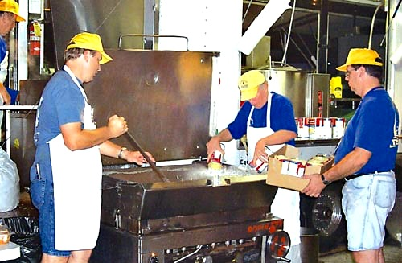
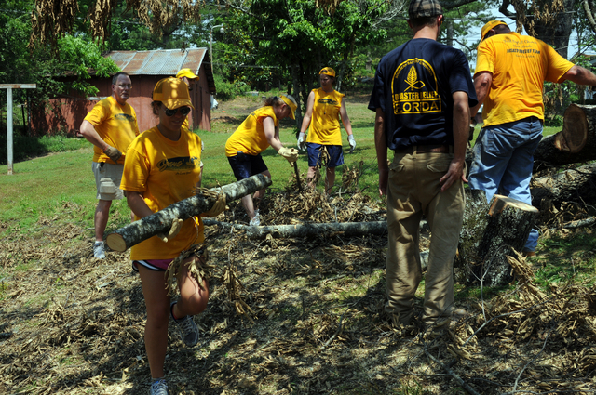
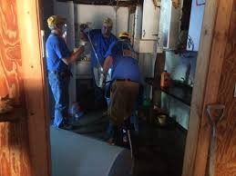
Tennessee Baptist
Disaster Relief Training
April 2nd
Parkway Baptist Church
Goodlettsville, TN.
For more info,
contact Bill Myers
615-879-1844
bill@myerscom.com

Slide 5
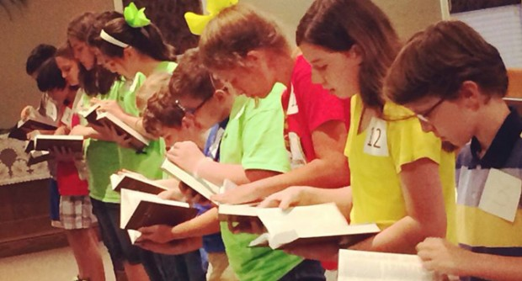
Wilson County Baptist
Associational Bible Drill
April 10th
2:00 pm to 4:00 pm
Fall Creek Baptist Church

Slide 6
Wilson County Baptist Association
Sunday School Training
April 22nd – 23rd
Immanuel Baptist Church
Friday: 6:30 pm - 9:00 pm
Saturday 8:30 am - 4:00 pm
For more info, see Pastor Greg.

Slide 7
Wilson County Baptist
Associational Senior Adult
“Old Fashioned Meeting”
May 15th to May 17th
More details are coming soon!

Slide 8
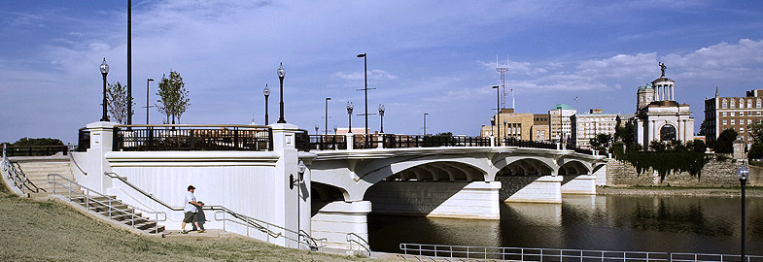
We Are Going On A Summer Mission Trip
June 26th – 30th
To Hamilton, OH (Just North Of Cincinnati, OH)
More information will be coming soon in the bulletin, so be watching for it!

Slide 9
Hey Kids! It’s Time For
Wilson County Baptist Association
July 18th to 22nd $180 per person
Theme: The Great Shepherd—Psalm 23
Camp pastor: Michael Kirby
Camp Worship Leader: Jason Harlin

Slide 10
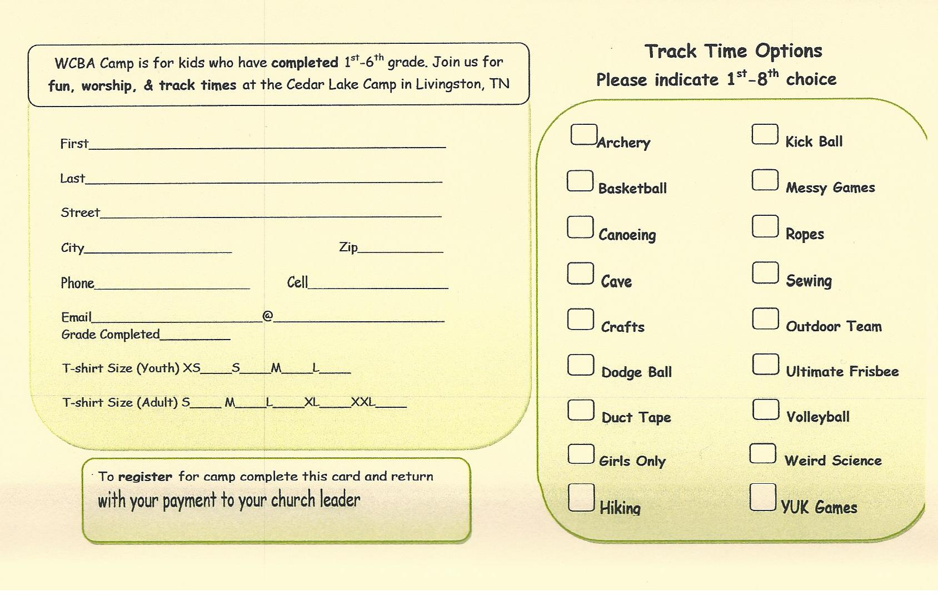
Registration cards are on the table at the back of the auditorium. Fill one out and give it to the Children’s Ministry Team.
(John & Meg Buchanan, Heath & Robbie Springer, William & Brandy Pulley)

Slide 11
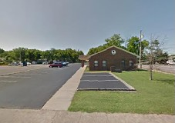
Would you like to receive a copy of the Wilson County Baptist Association Newsletter?
Contact Tricia
615-444-8820
wcba@wcbamissions.com

